Slide 1
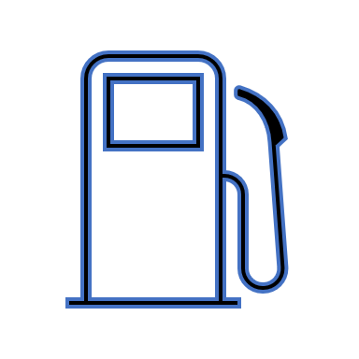


EDUp FORDCS V1.0 Planning
Vienna, April.2022
F
Compendium
FORDSC Project
Edu Platform
v2022.04
MSc. Ömer Karacan
karacankos@gmail.com
Template v2022.04

Slide 2
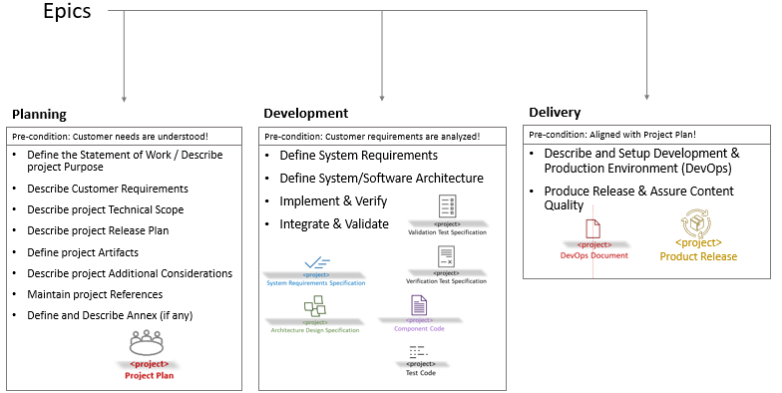
SwPD Method Epics - Setting
Source: EDUp-Full-Stack-Software-Project-Development-Method.pptx

Slide 3
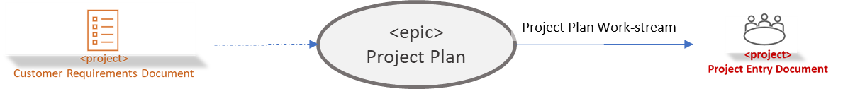
Document Context
A Link to the method:

Slide 4
Statement of Work / Purpose
Edu-simulate a charging station using webservices framework of Spring with internal Database → FORDCS V1.0 Software !
All artifacts of the Software Project Development Method (SwPDM) should be created as an example for the future projects!
Implement and test the FORDCS V1.0 Software based on customer requirements and Swagger API design!
The Software implementation and testing should be done on premise!
The Software acceptance test should be conducted on Azure Cloud!

Slide 5
Customer Requirements
The customer requirements are defined in a set of slides!
EDUp-FORDCS-V1.0 Customer-Requirements-v2022.04.pptx
The FORDCS V1.0 API is designed by a Swagger API!
The app should offer a Swagger document API!
The app should be deployed to Azure Cloud!
The acceptance test should be conducted while app is running on Azure Cloud!

Slide 6
Project Technical Scope
The EDU-simulation of the charging station is a service-based software component runnable on a PC or Cloud!
It is used, managed, tested, and maintained over the webservice endpoints!
The behavior is defined by a state machine, which simulates a charging process!
It is an executable software that is independent to a specific hardware!
Development environment is Eclipse where Spring and Junit 4 are installed!
Deployment environment is a PC and a Cloud Container!
3rd party system dependency like a Database is not defined yet!
System test tool is Postman or alike!
Notes:
The technical scope of a software project defines the technical boundaries of the project, such as
Result definition – what technical functionality is provided / what not – technical characteristics & features (narrative)
What is inside / what is outside of the system – illustrated physical environment
Development environment - 3rd party products to use
Deployment environment
3rd party products to integrate/utilize

Slide 7
Project Release Plan
The project release plan has three iterations with an incremental result:
Iteration “A minimum viable product (MVP)”: One use case implementation on Spring Controller/Service/Repository layers! → Use Case “Report Factory Setting V1.0”
Iteration “Charging with Status Report”: Realization of the following use case analog to the MVP: → Use Case “Run-time Status Report”
Iteration “Charging with Status Report”: Realization of the following use case analog to the MVP: → Use Case “Monitor and Control Run-time Status”
All iterations conduct unit tests and system tests of the system running on a PC, and on the Azure Cloud, including the documentation according to SwPDM!

Slide 8
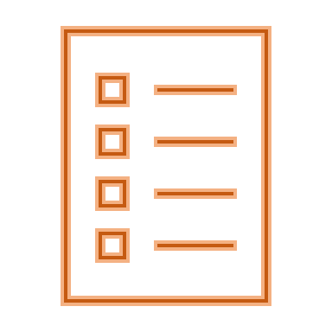

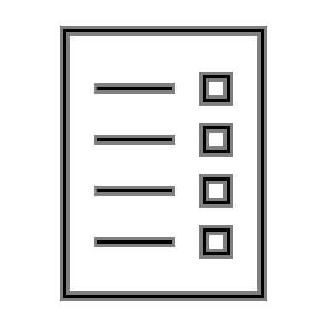




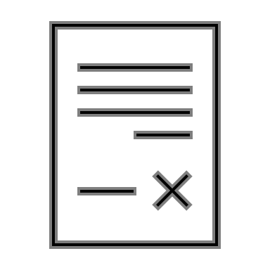

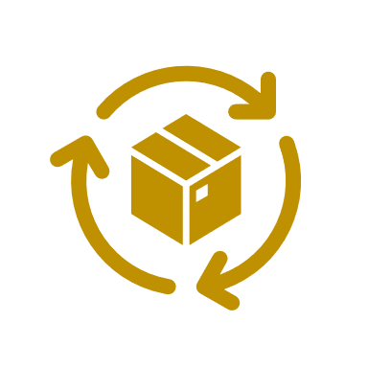
FORDCS-V1.0 Project Artifacts
<project>
Customer Requirements Document
<project>
Test Code
Project Setup Work-stream
FORDCS-V1.0
EDUp FORDCS-V1.0 Project-v2022.04
FORDCS-V1.0
EDUp-FORDCS-V1.0 Customer-Requirements-v2022.04.pptx
<project>
Validation Test Specification
<project>
System Requirements Specification
Acceptance Test Work-stream
<project>
Test Code
Requirements Analysis Work-stream
<project>
Validation Test Specification
<project>
Test Code
<project>
EDUp FORDCS-V1.0 System Requirements.v2022.04.pptx
System Test Work-stream
Test Code Work-stream
<project>
Architecture Design Specification
Architecture Design Work-stream
DevOps Document
<project>
EDUp-FORDCS-V1.0-Architecture Design-v2022.03-1.pptx
<project>
Validation Test Specification
<project>
DevOps Document
Integration Test Work-stream
DevOps Work-stream
<project>
Verification Test Specification
<project>
Component Code
Implementation Work-stream
<project>
Test Code
<project>
Component Code
Unit Test Work-stream
<project>
Product Release
Cycles
Delivery Work-stream
Text Template: <artifact-name> work-stream)

Slide 9
Additional Considerations
Implementation of the MVP Is the most critical one, since it is the first vertical (full-stack) implementation of the system.
The MVP has a “role model” regarding to implementation, test, deployment, and documentation, therefore, its realization will take longer than the follow-up iterations.
How-To’s should be created and added to the documentation!
The documentation scope is the PowerPoint slides in the first 3 iteration!

Slide 10
Project References
[SAFe] … https://www.scaledagileframework.com/agile-product-delivery/

Slide 11
<Annex - > <topic name>>

Slide 12
Project Glossary

Slide 13
Backyard

Slide 14
EDUp Project Story Stream
00
00
00
00
Customer Scope
00
00
00
00
Supplier Scope
User Scope

